Slide 1


Green Pace
Security Policy Presentation
Developer: Evan Rihel

Slide 2

OVERVIEW: DEFENSE IN DEPTH
This will give an overview of the methods that we will use to ensure that we are using safe and secure practices and ensure secure coding.

Slide 3
THREATS MATRIX
Likely Threat is Likely to Occur | Priority Standard Priority with High Relevancy
Low priority Standard Priority with Low Relevancy | Unlikely Threat is Unlikely to Occur
Coding comes with levels of vulnerability to threats. To ensure secure Coding, Here is a table to display the Threat/Priority levels.

Slide 4
10 PRINCIPLES
Validate Input Data
Heed Compiler Warnings
Architect and design for security policies
Keep it simple
Default deny
Adhere to the principle of least privilege
Sanitize data sent to other systems
Practice defense in depth
Use effective quality assurance techniques
Adopt a secure coding standard

Slide 5
CODING STANDARDS
Do not cast to an out-of-range enumeration value
Guarantee that container indices and iterators are within the valid range
Do not attempt to create a std::string from a null pointer
Avoid using default operator new for over-aligned types
Properly deallocate dynamically allocated resources
Incorporate diagnostic tests using assertions
Handle all exceptions
Use valid iterator ranges
Detect and handle memory allocation errors
Do not attempt to create a std::string from a null pointer

Slide 6
ENCRYPTION POLICIES
Encryption at Rest
Encryption at Rest is to keep the attacker from accessing unencrypted data. This is done by keeping data encrypted when it is not in use. Then even if the attacker gains access, they must first decrypt the files.
Encryption in Flight
Encryption in Flight is the practice of encrypting data while it’s being transmitted. So if the data is intercepted, it must be decrypted first. This data is then decrypted by the proper receiver with their keys.
Encryption in use
Encrypted in use is data that remains encrypted while it is being used so that the keys never become available to be stolen

Slide 7
TRIPLE-A POLICIES
Authentication
Authentication is the allowance of access to files that are normally restricted. This is normally granted with a username and password.
Authorization
Authorization is the use of allowing access to a higher level of files to already Authenticated users.
Accounting
Accounting is the process of monitoring users and their activity on their Authorization levels as well as removing or De-Authorizing users who lose access, so it does not cause a security breach.

Slide 8
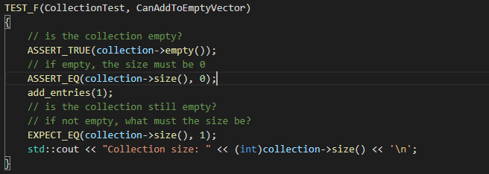
Unit Testing
Test 1
CanAddToEmptyVector
The Purpose of this test is to verify that a vector object can be have element’s added to it properly.

Slide 9
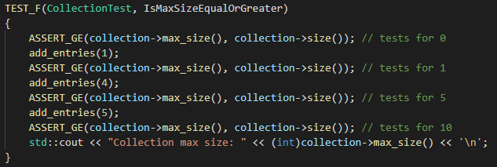
Unit Testing
Test 2
IsMaxSizeEqualOrGreater
The Purpose of this test is to verify that a that max size of the collection is greater than or equal to size for 0, 1, 5, 10 entries

Slide 10
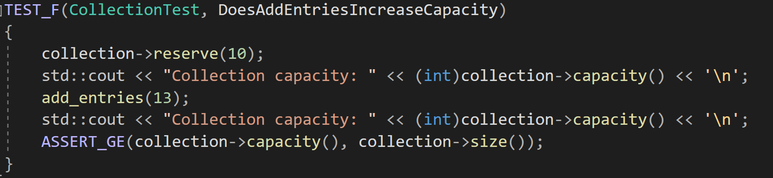
Unit Testing
Test 3
DoesAddEntriesIncreaseCapacity
The Purpose of this test is to verify that a that the add_entries() method increases the capacity of the collection.

Slide 11
Unit Testing
Test 4
IsMaxSizeEqualOrGreater
The Purpose of this test is to verify that a that max size of the collection is greater than or equal to size for 0, 1, 5, 10 entries

Slide 12

AUTOMATION SUMMARY

Slide 13
TOOLS
The DevOps Pipeline is a asset of practices that allow developers to securely build, test and deploy software.
Testing early and often in development is a good way to catch security errors from occurring throughout the process.

Slide 14
RISKS AND BENEFITS
When coding, there will always be security risks. No code is completely secure. Threats can come through means of User Input, accessing memory registers of secure information or even through laziness in maintaining a secure system. This policy should help to mitigate risk by promoting security at every level.

Slide 15
RECOMMENDATIONS
New threats emerge often with new code being written and old exploits being discovered. Be educated and mindful of new coding practices to be aware of possible new exploits that could case a security breach.
Many security breaches occur due to poorly maintained Access control systems. Even the most secure systems can become vulnerable if authorization is not removed from someone who should not posses it.

Slide 16
CONCLUSIONS
In Conclusion, we demonstrate a high priority for secure coding using the principals and standards highlighted above. Security shouldn’t be a final addition before releasing a program. It should be thought of and implemented throughout the development process to ensure the most secure programs.

Slide 17
REFERENCES
Software Engineering Institute. (n.d.). Retrieved February 2022, from https://www.sei.cmu.edu/

